Slide 1
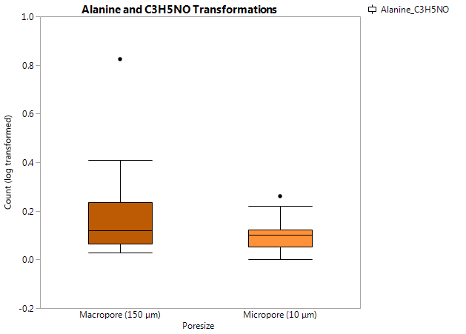
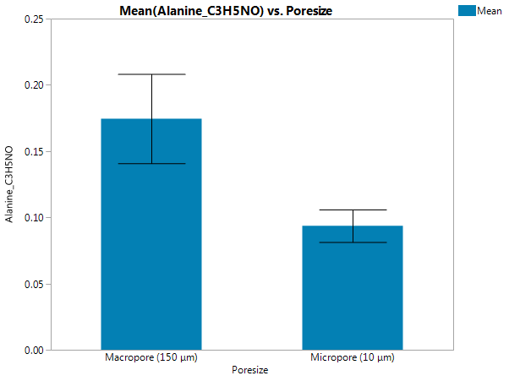
Alanine: Non-polar, hydrophobic, ambivalent amino acid in the aliphatic group. It is interchangeable with pyruvate via transamination. Alanine is one of the most abundant amino acids in soil DOC and is an important component of root exudates.
Increased processing of glycine in macropores compared to micropores (p < 0.05). No differences in pyruvate processing between pore size domains.
Main Effect:
p = 0.0213 for pore size domain, no effect of inoculant or interaction.
Notes:
Alanine is abundant in soils – 15% of amino acids recovered in DOC and are key components in root exudates (Fisher et al. 2007, 2010 from Apostel et al. 2013 SBB 67:31-40).

Slide 2
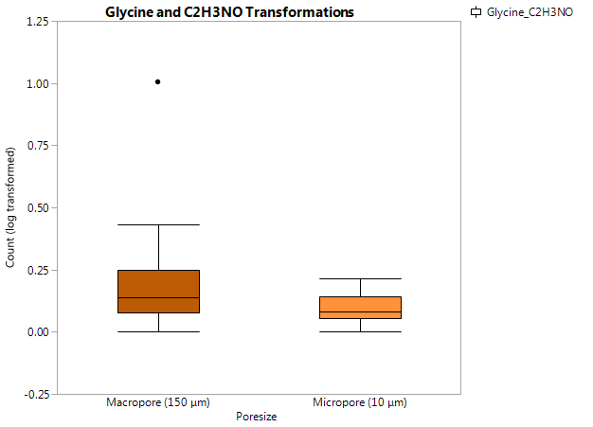
Glycine: Non-polar ambivalent amino acid in the aliphatic group.
Increased processing of glycine in macropores compared to micropores (p < 0.01)
Main Effect:
p = 0.00098 for pore size domain, no effect of inoculant or interaction.
Notes:
Glycine – smallest amino acid, non-polar, glucogenic, important component and precursor for many macromolecules in the cells.

Slide 3
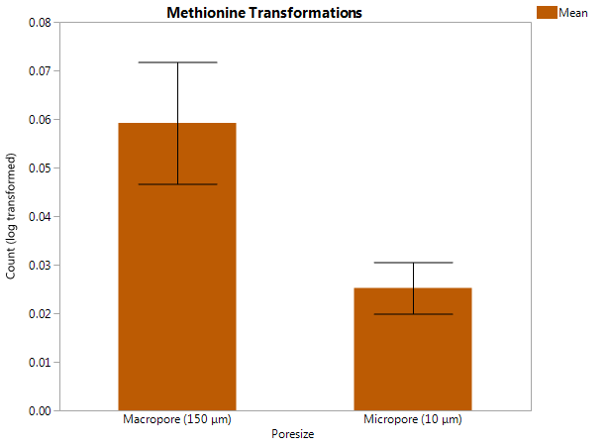
Methionine: Sulfur-containing amino acid, the side chain is hydrophobic Increased processing of methionine in macropores compared to micropores (p < 0.05)
Main Effect:
p = 0.0175 for pore size domain, no effect of inoculant or interaction.
Notes:
Methionine – proteinogenic amino acid and involved in the initiation of translation. It plays a structural role in hydrophobic cores of proteins (like other hydrophobic amino acids – valine, leucine, isoleucine). It has also been associated with acting as a redox sensor. It is a less abundant amino acid in bacteria, but is an important part of a co-factor (SAM) that is a key carrier of methyl group.

Slide 4
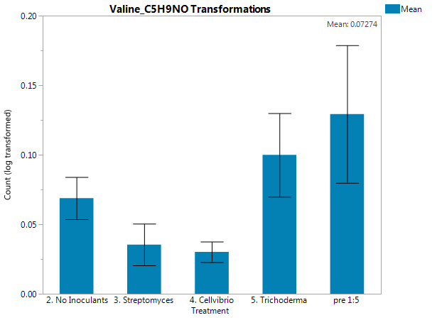
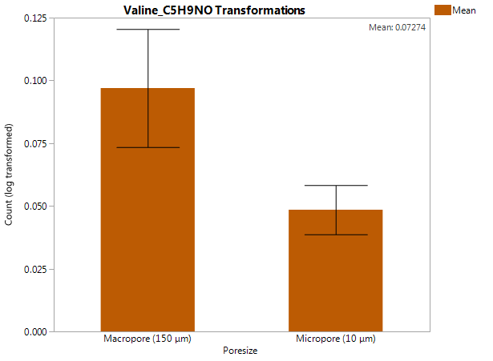
Valine: Hydrophobic, nonpolar, aliphatic amino acid. Increased processing in macropores (p < 0.05) and reduced in Cellvibrio and Streptomyces- inoculated pore waters.
a
ab
ab
b
b
Main Effect, p = 0.0487
p = 0.0441
Notes:
Valine – hydrophobic (often located in interior of proteins), I has a hydrocarbon side chain (or a branched chain amino aid) and is nonpolar, but in the aliphatic R-group. Graph Builder
Each error bar is constructed using 1 standard error from the mean.

Slide 5
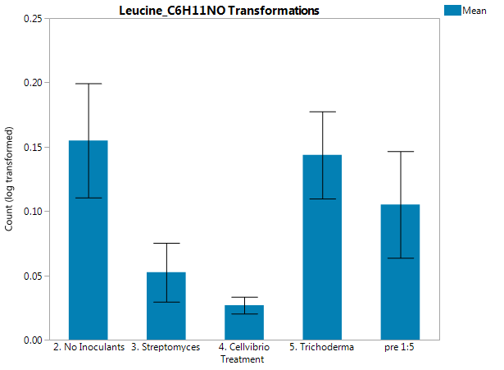
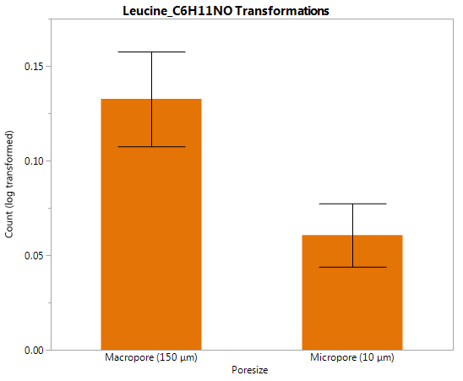
Leucine: Hydrophobic, nonpolar, aliphatic amino acid with branched hydrocarbon side chain. Leucine decomposition are relatively stabilized in protected (within aggregates or sorbed to minerals) spaces (Bartlett & Doner, 1998).
Increased processing in macropores (p < 0.005) and reduced in Cellvibrio-inoculated pore waters.
a
a
ab
bc
c
Main Effect, p = 0.0027
p = 0.0028
Notes:
Bartlett and Doner, 1998 SBB 20(5):755-759 “decomp of leucine in soil aggregates”

